Slide 1

Sprocket Central Pty Ltd
Data analytics approach

Slide 2
Agenda
The approach followed by team in three steps :
Data Exploration
Model Development
Interpretation

Slide 3
Introduction
Approach for new customer data analysis
Data exploration in -
Sales distribution in age groups and ‘male and female’ customer ratio.
Sales based on job industry and product class
Sales by region
Brand performance for product line

Slide 4
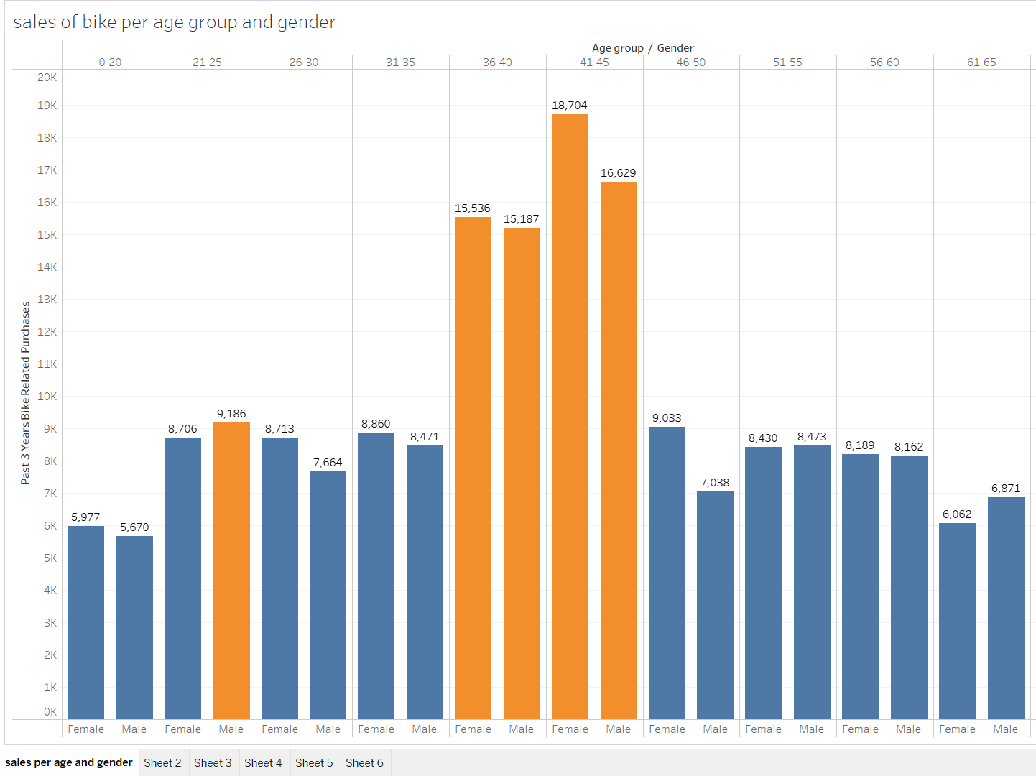
Data Exploration
Sales distribution in age groups and ‘male and female’ customer ratio
In the age group between 36 to 45, are highly valuable bike customers followed by age group 21-25.
The data shows females of age group 41 to 45 are highest purchasing customers.
Below 20 or above 65 has low number of customers.
Age group 21 to 25 which is considered as college going student, could also be the target group.
In age groups 41 to 45 and 46 to 50, huge difference can be noticed as female purchased more than males

Slide 5
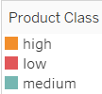
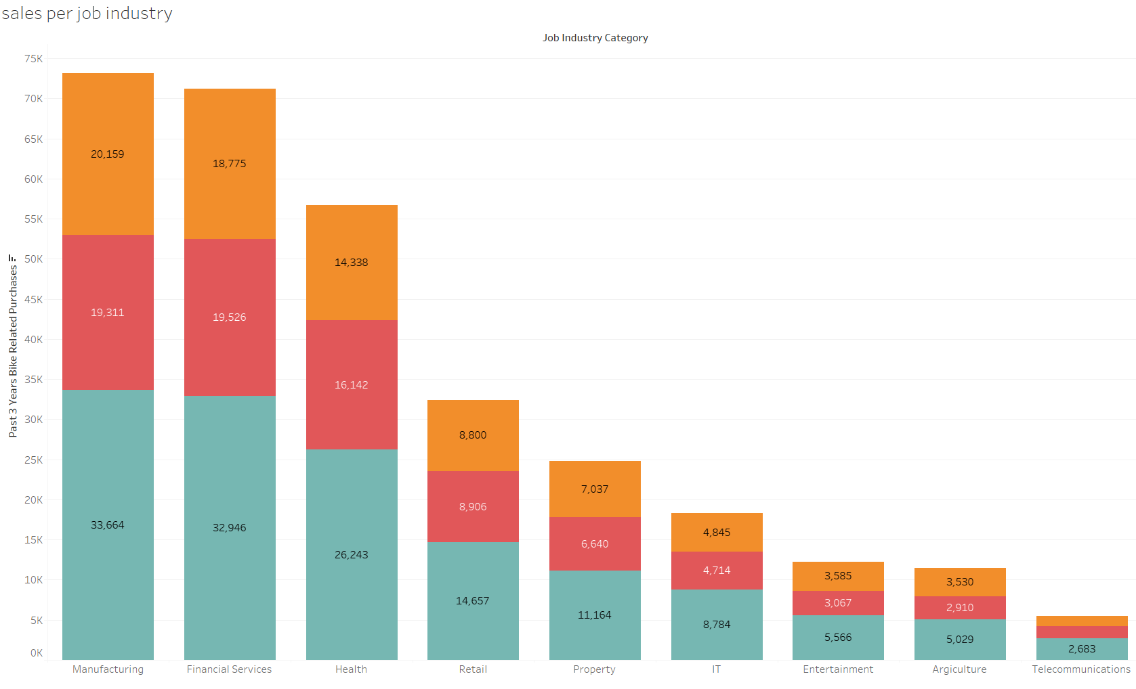
Data Exploration
Sales based on job industry and product class
Manufacturing industry has highest sale record followed by financial services and health department.
Product class Medium has the largest share of sale in all the industry types.
In manufacturing industry low class product is least in demand.
Agriculture and telecommunication industry has least bike sale.

Slide 6

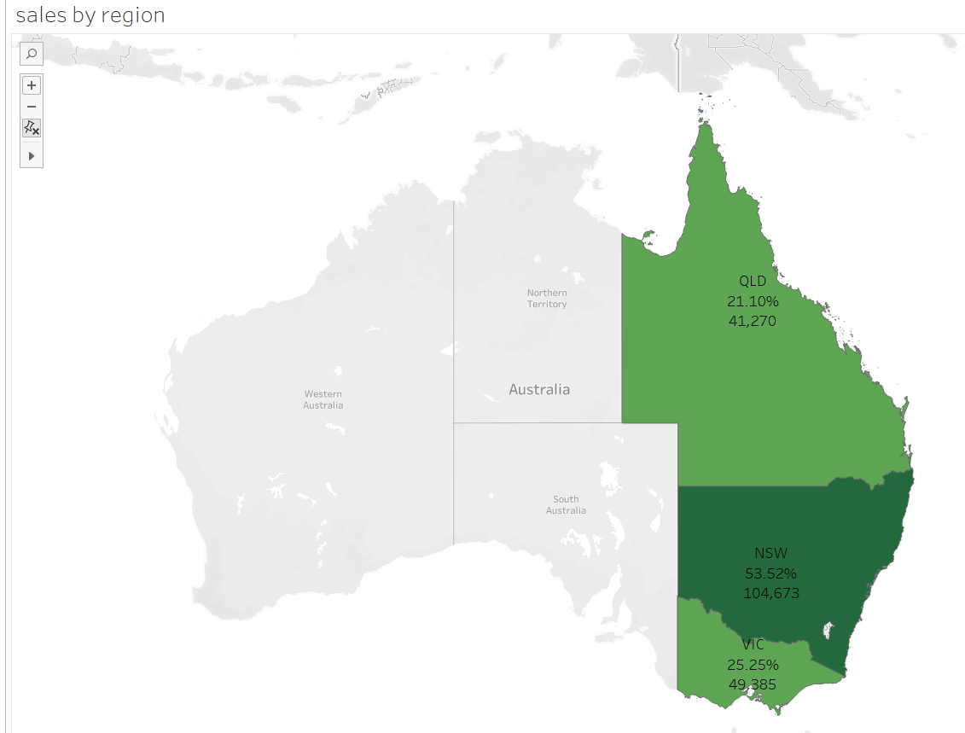
Data Exploration
Sales by region
NSW has the 53 % percent of total sales. It will be the focus region for sales
As NSW is doing good in sales perspective, we can plan better strategy in connecting areas.
QLD has lowest sales records

Slide 7
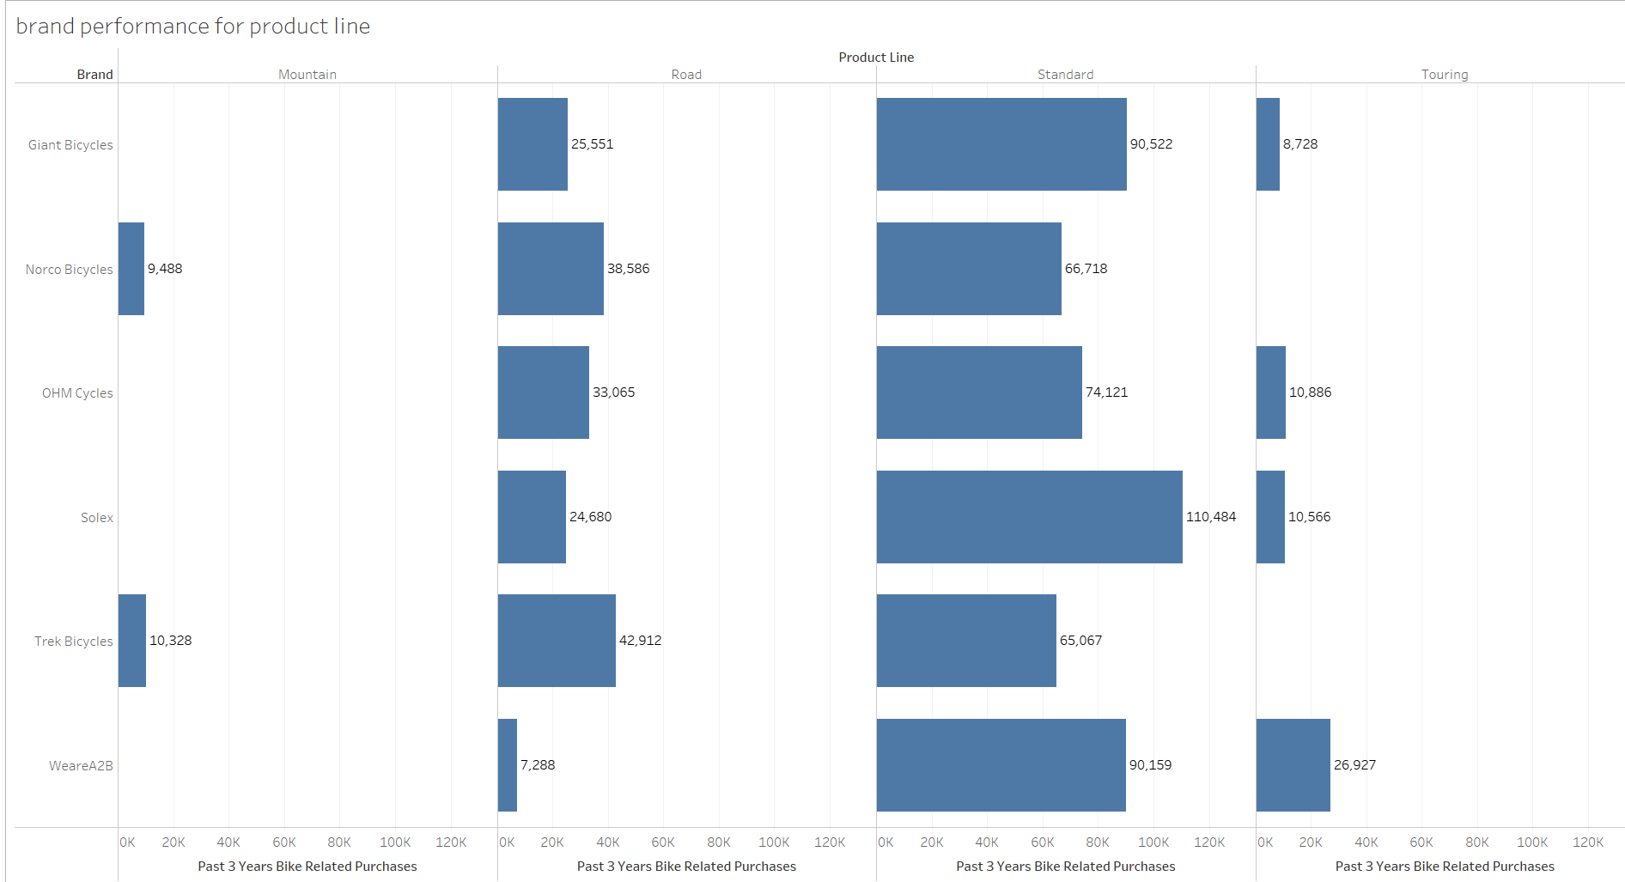
Data Exploration
Brand performance for product line
Standard is most purchased product among all the product lines.
Standard is most selling product line for all the brands.
Mountain bikes and touring bikes are least sold product line.
Solex has the highest sell record of standard bikes.

Slide 8
Model Development
Customer classification – Valuable target customers from new list
Age group between 36-45
Females are more valuable customers than men
Customers from Manufacturing industry, financial services and health department.
Medium product class is best selling
Customer living in NSW
Mostly customer likes standard product

Slide 9
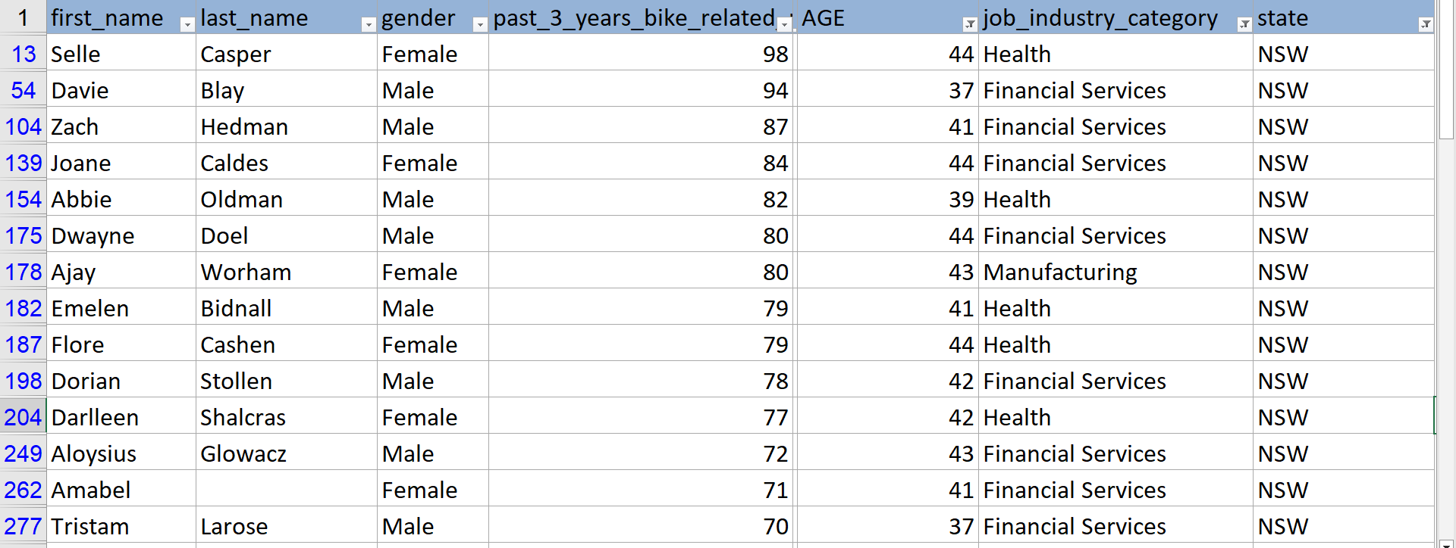
Interpretation
Using the 3 datasets (Customer demographic, customer address and transactions)
the recommendation table for the most valuable customer from 1000 new customers dataset are:

Slide 10
Thank you

Slide 11
Appendix
In new customer data set there some data quality issues found:
There are some customers whose age is 122.
Many numbers are stored as text format

